Slide 1
Van Emde Boas Trees (vEBT): “Efficient Search and Update Operations“ By Anupama avusula Sri sai harsha Gannamaneni

Slide 2
"A data structure revolutionizing search and update efficiency"
Welcome to the presentation on Van Emde Boas Trees (vEBT), a groundbreaking data structure.
Invented by computer scientist Peter van Emde Boas and his team in 1975.
Plays a pivotal role in optimizing search and update operations.

Slide 3
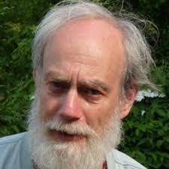
History
Peter van Emde Boas
Developed by Peter van Emde Boas and team in 1975.
Significant contribution to the evolution of data structures for more efficient operations.

Slide 4
Structure of vEBT
Recursive structure defining vEBT.

Slide 5
Main components
Cluster
A group of elements arranged to optimize cache utilization, enhancing vEBT's efficiency in storing and retrieving key values.
Summary
A concise representation summarizing information about clusters, aiding in quick identification and navigation within the vEBT structure.
Recursive calls
Iterative process where vEBT invokes itself to handle substructures, contributing to its hierarchical design and efficient search and update operations.

Slide 6
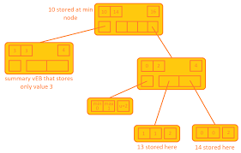
1
TRANSITION HEADLINE
Data Structures Van Emde Boas Trees

Slide 7
Key Operations
All operations in O(lg lg n) time.

Slide 8
INSERT
Efficiently adds a new element, maintaining vEBT's hierarchical structure and ensuring optimal time complexity for insertion operations.
DELETE
Removes an element, adjusting the structure seamlessly to preserve vEBT's logarithmic time complexity for deletion operations.
MINIMUM
Quickly retrieves the smallest element, leveraging vEBT's O(1) time complexity for minimum queries, enhancing search efficiency.

Slide 9
MAXIMUM
Speedily retrieves the largest element, capitalizing on vEBT's O(1) time complexity for maximum queries, facilitating efficient search.
SUCCESSOR
Locates the next element in order, employing vEBT's unique structure to achieve O(lg lg n) time complexity for successor operations..
PREDECESSOR
Identifies the previous element in order, utilizing vEBT's hierarchical design to attain O(lg lg n) time complexity for predecessor operations.

Slide 10
Time Complexity
vEBT's time complexity advantage:
O(lg lg N) for search, successor, predecessor, insert, and delete operations.
Outperforms related data structures like priority queues and binary search trees.

Slide 11
Pro and Cons
Advantages:
O(1) time complexity for minimum and maximum queries.
Efficient operations on a large scale.
Limitations:
Restricted to integer keys.
Challenges in adoption due to specific use cases.

Slide 12
What is preventing vEBT from being used more?
Van Emde Boas Trees (vEBT) face limited adoption due to potential overhead in compressing binary trees, especially in scenarios with frequent cache misses or large tree sizes. Its usage is often niche, addressing extreme performance issues. Additionally, vEBT's complexity is tied to the value universe size, restricting key types to integers. While not superior to arrays for storage and lookups, vEBT excels in offering efficient minimum, maximum, predecessor, and successor operations, making it valuable in specific contexts.

Slide 13
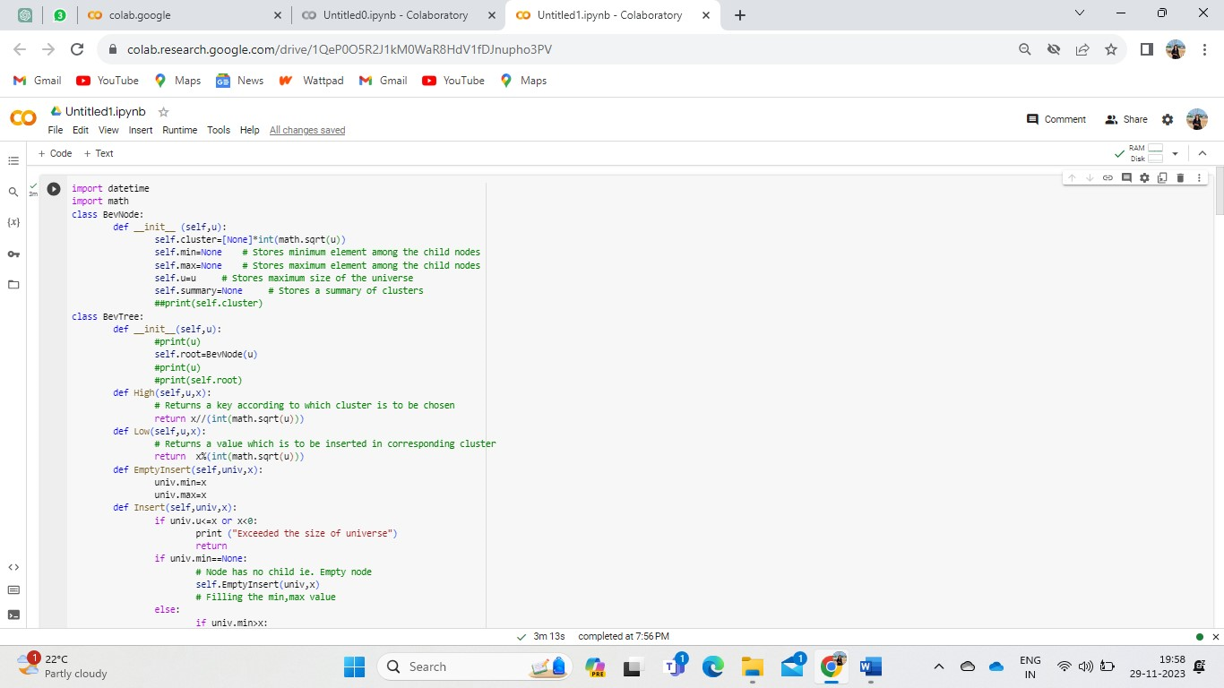
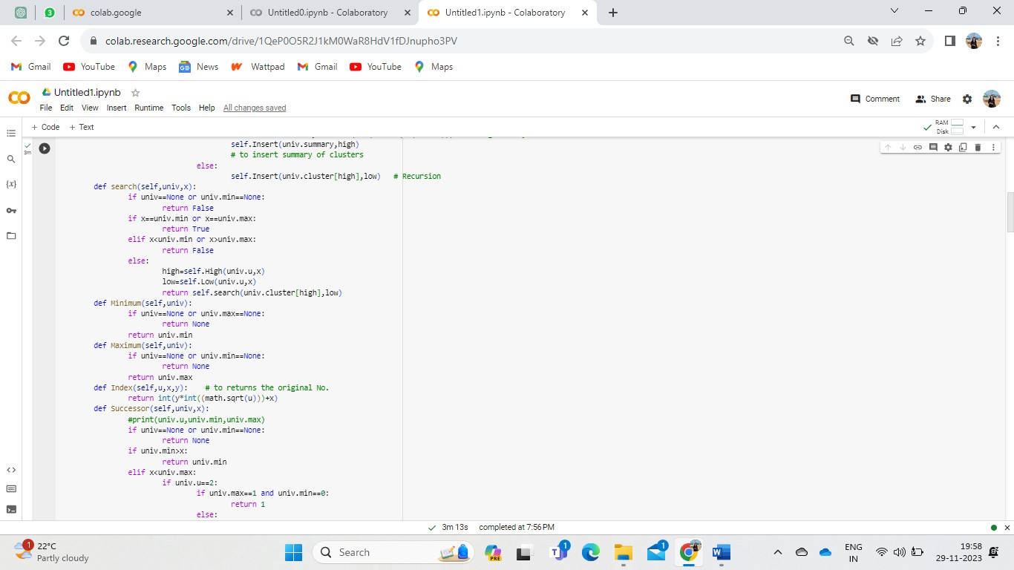

Slide 14
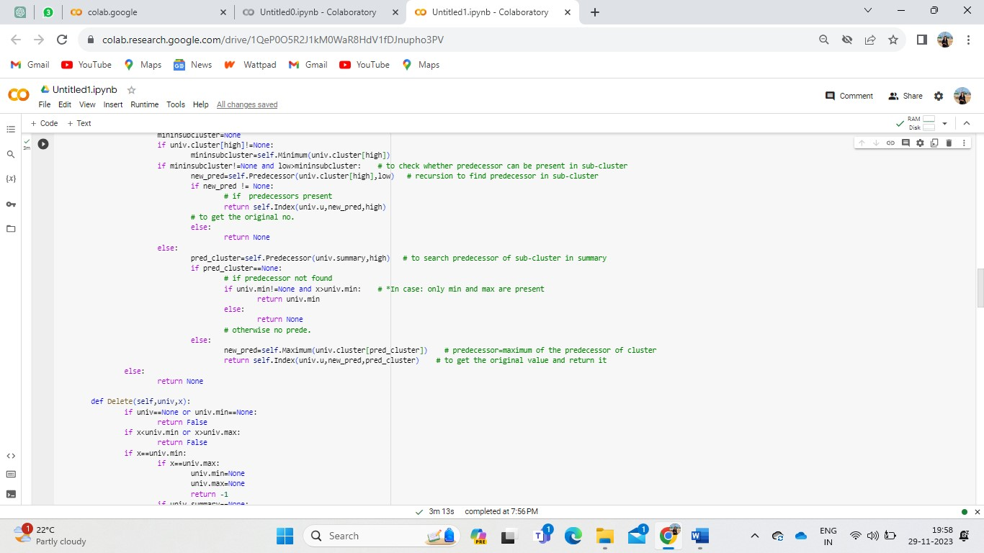
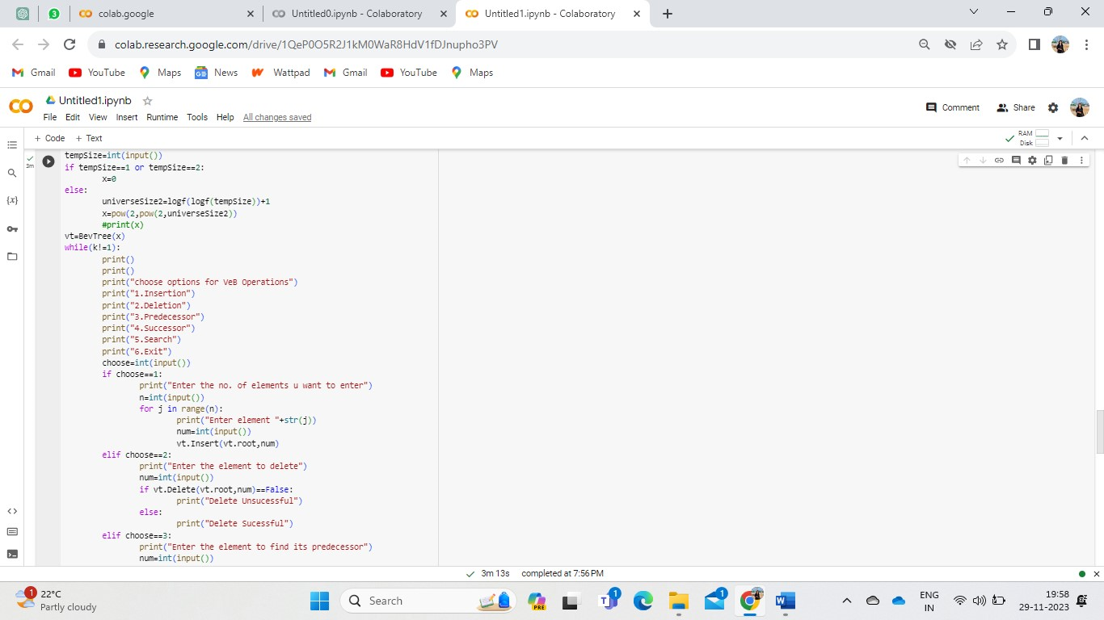

Slide 15
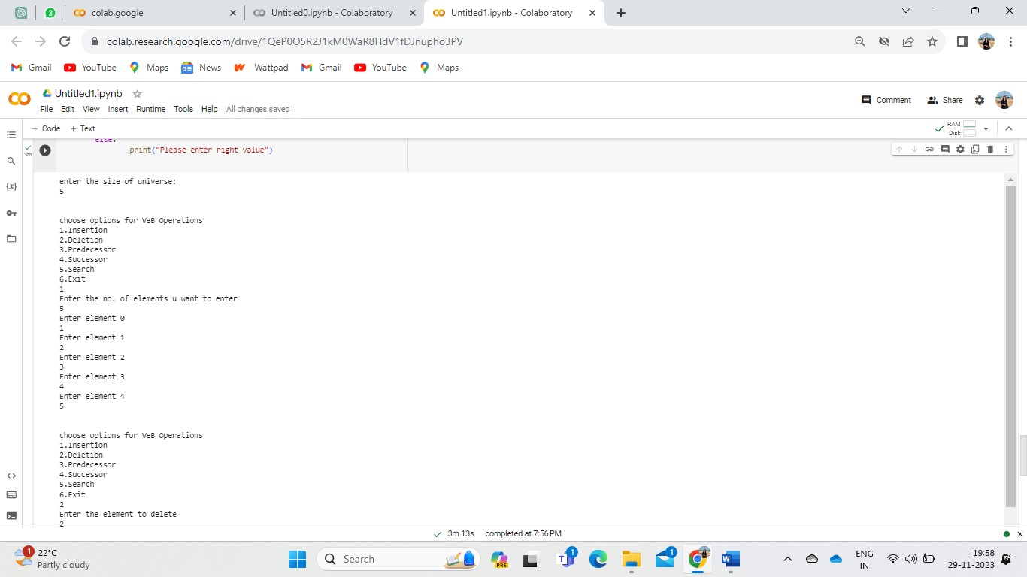
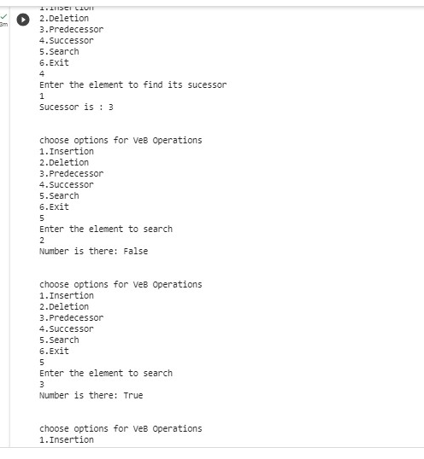

Slide 16
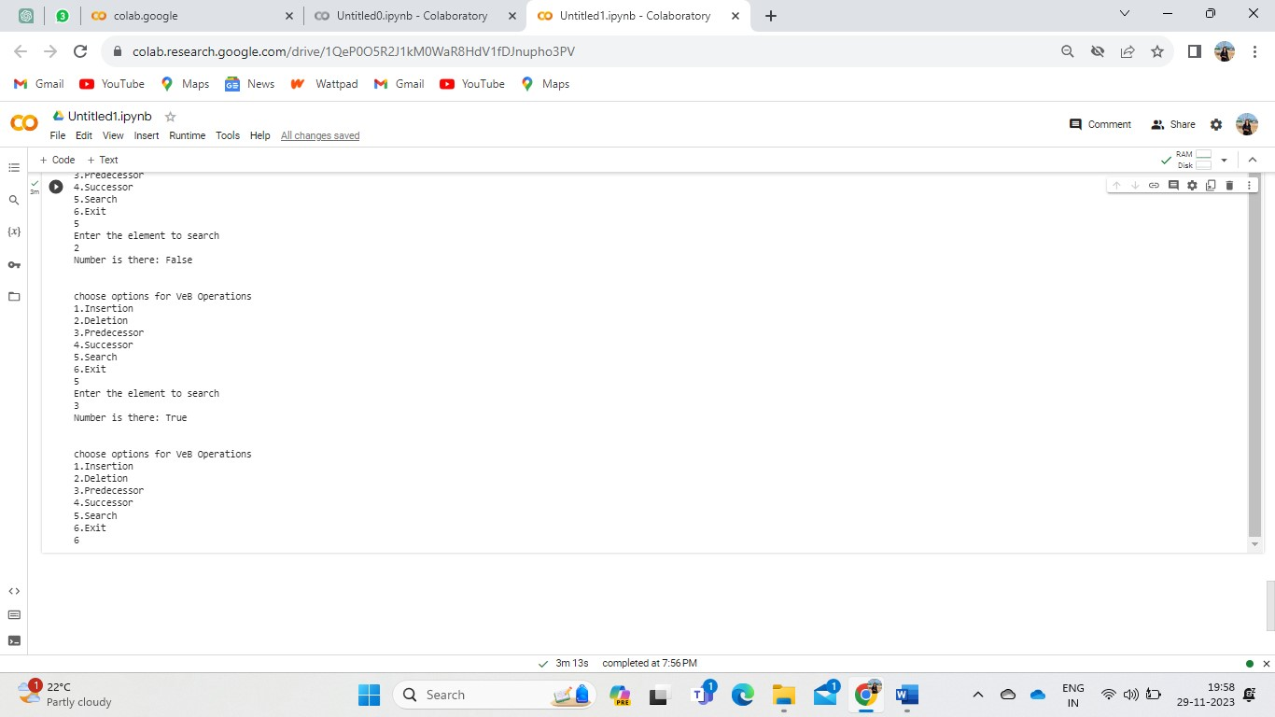

Slide 17
In Conclusion, Van Boas Trees revolutionize data structures,offering logarithmic time complexity for key operations. Their hierarchical design enhances search and update efficiency, marking a significant advancement in optimizing algorithms for large-scale applications.

Slide 18
Thanks!
ANY QUESTIONS?

